Slide 1

Eyes and Smile Detection
Detect Eyes and Smiles with the Viola and Jones algorithm
Mutschlechner Gerrit, Jonas Fauner, Jonas Huber

Slide 2
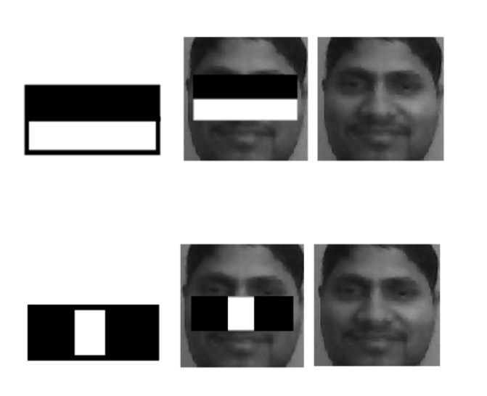
Haar-Like Feature

Slide 3
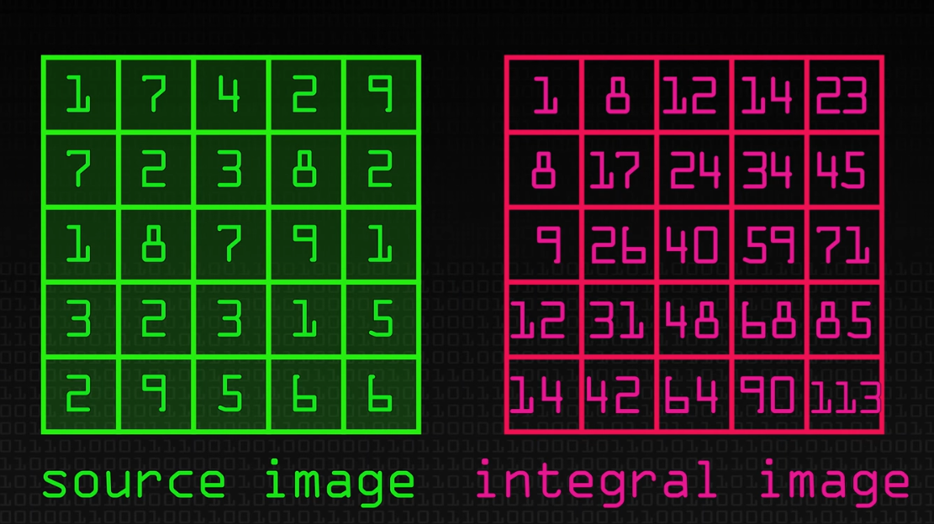
Integral Image
Image source: https://www.youtube.com/watch?v=uEJ71VlUmMQ

Slide 4
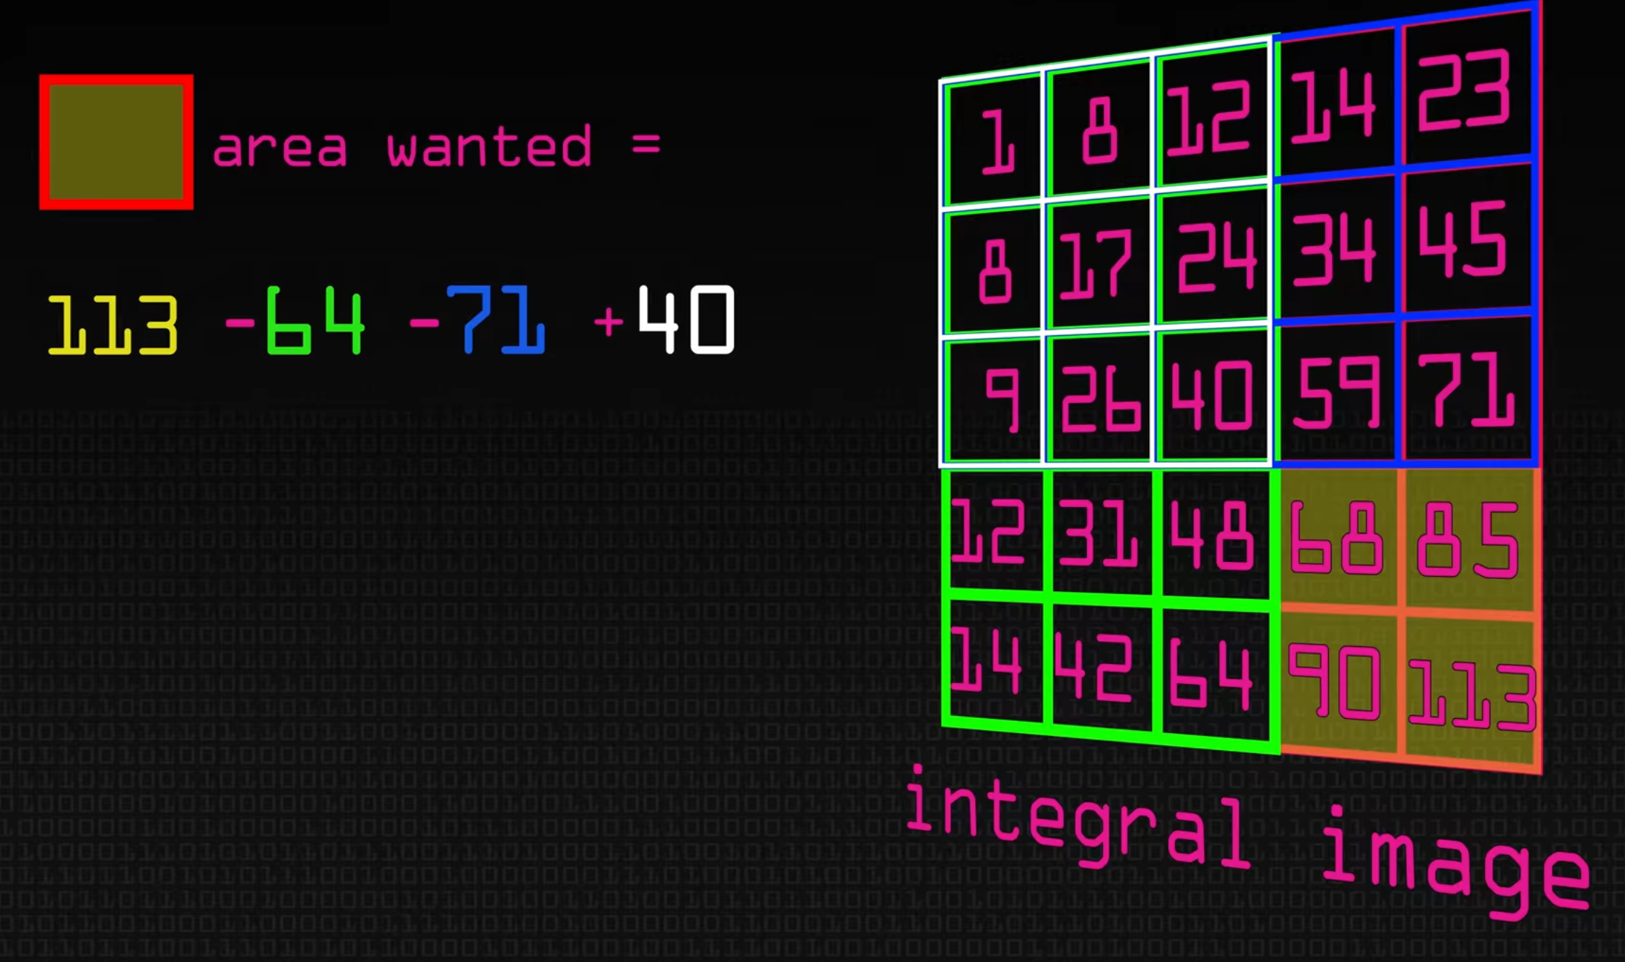
Integral Image

Slide 5
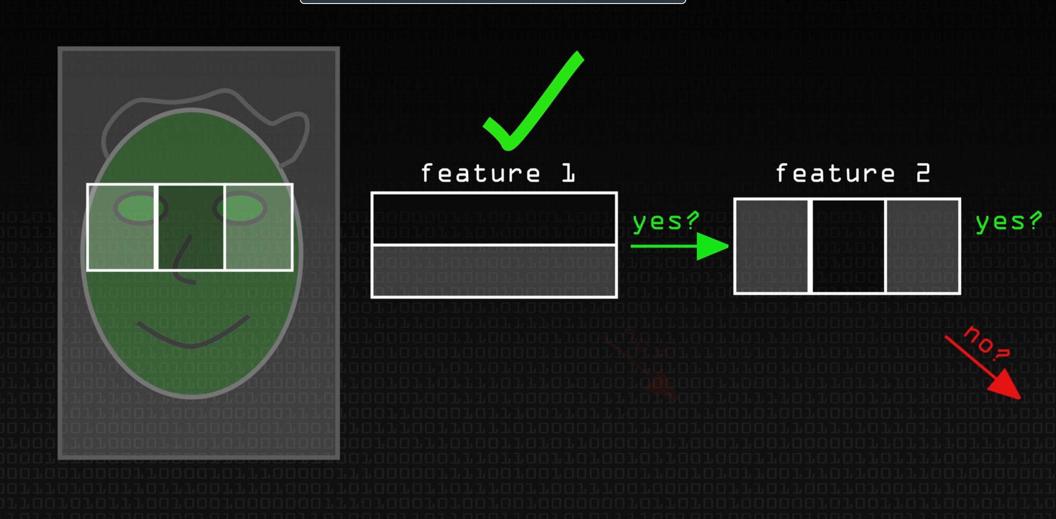
Cascade

Slide 6
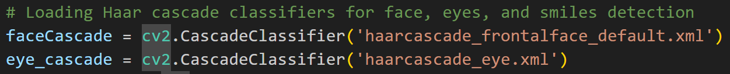
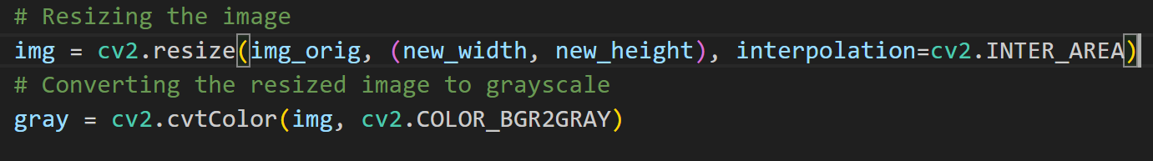
Code

Slide 7
‚detectMultiScale‘ Parameters
scaleFactor:
How much image size get reduced at each scale
Small: more detections
Large: reduce computation time
minNeighbors:
number of neighbors a candidate rectangle needs to have
Small: more detections
Large: fewer detections, better quality

Slide 8
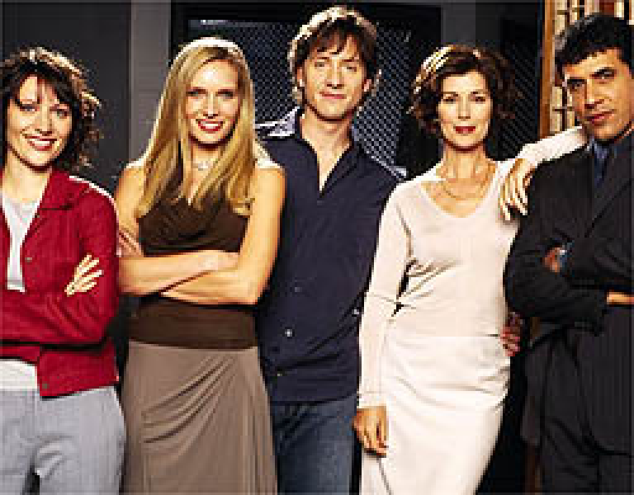
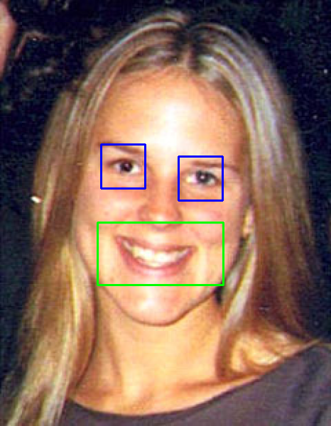
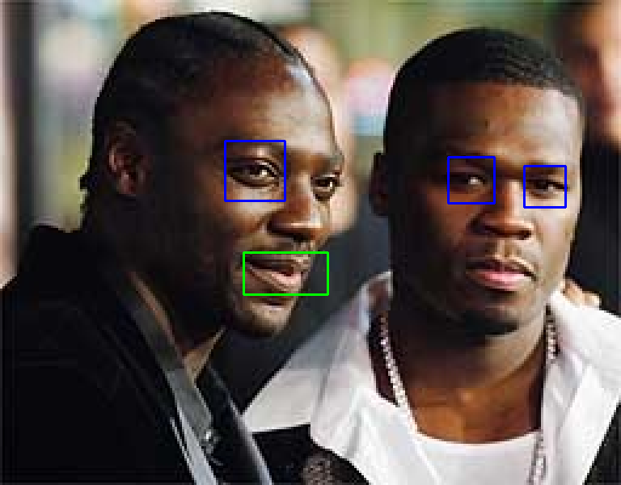
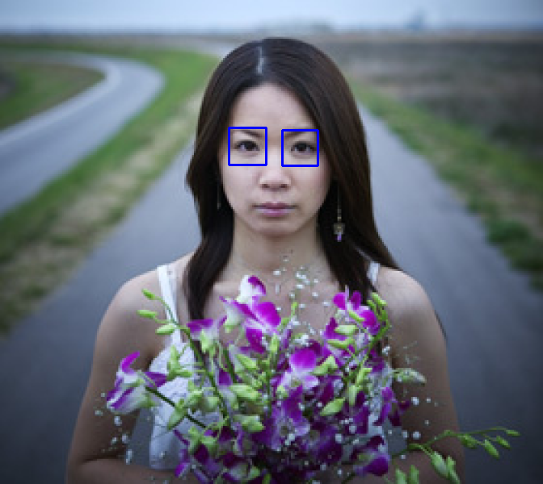
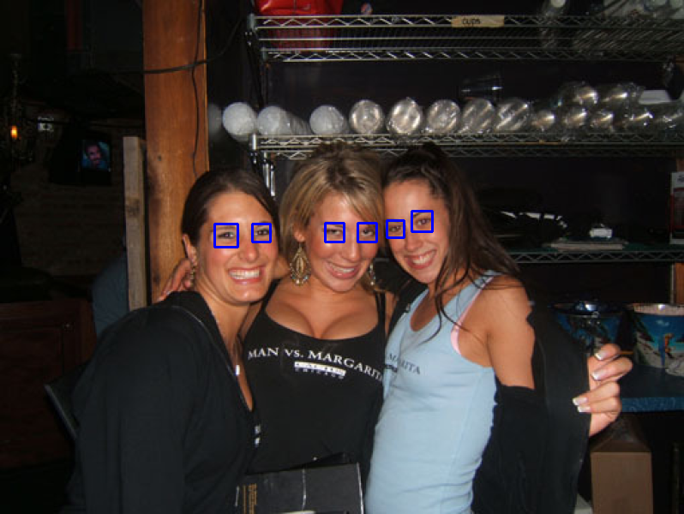
Eyes: scaleFactor=1.3, minNeighbors=3
Smiles: scaleFactor=1.7, minNeighbors=20

Slide 9

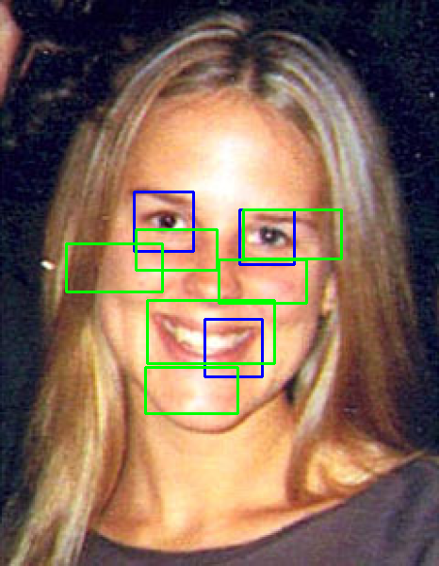
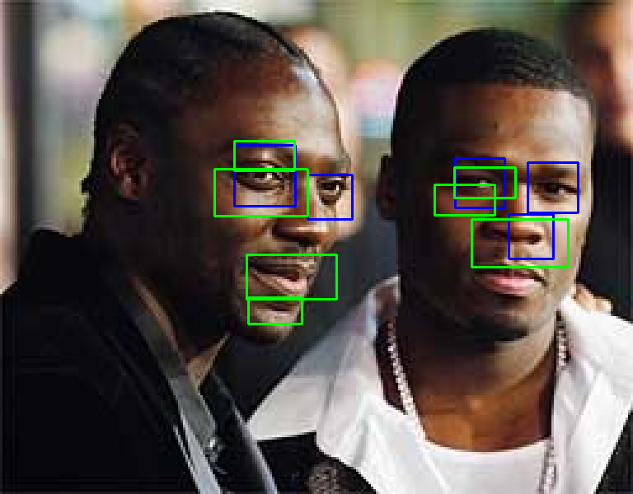
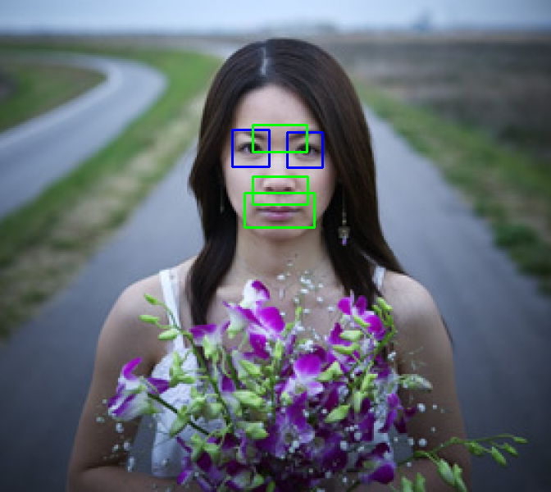

Eyes: scaleFactor=1.1, minNeighbors=3
Smiles: scaleFactor=1.1, minNeighbors=10

Slide 10

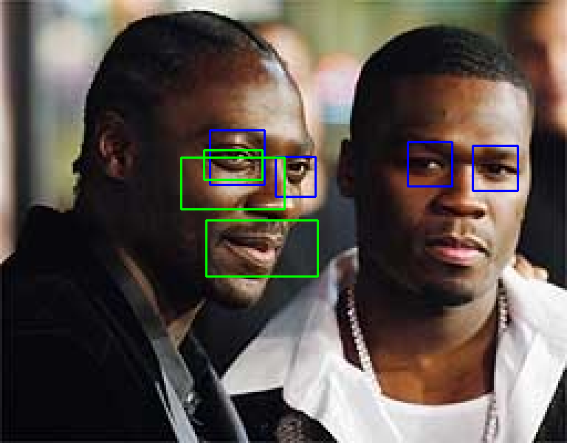
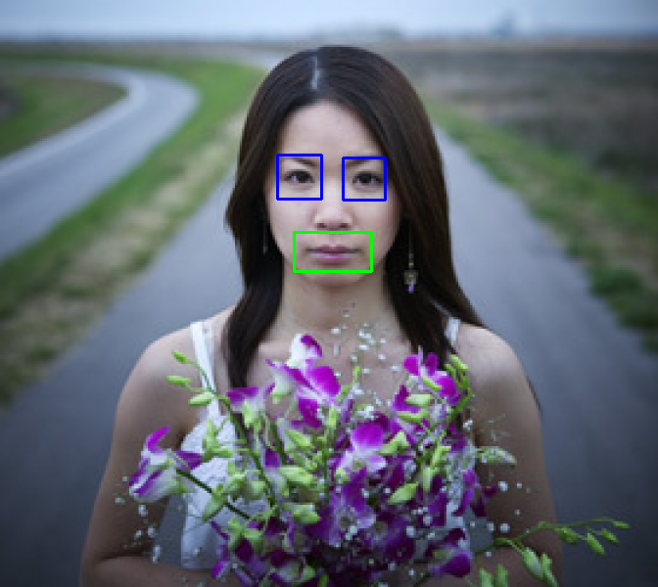
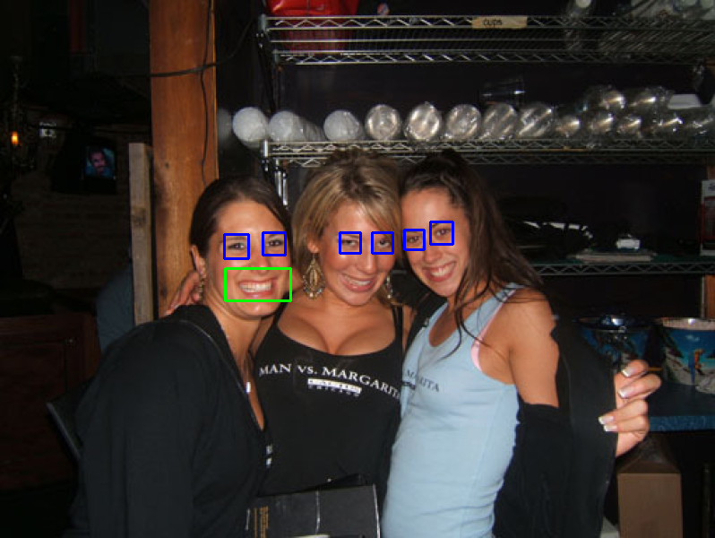
Eyes: scaleFactor=1.1, minNeighbors=7
Smiles: scaleFactor=1.3, minNeighbors=20

Slide 11


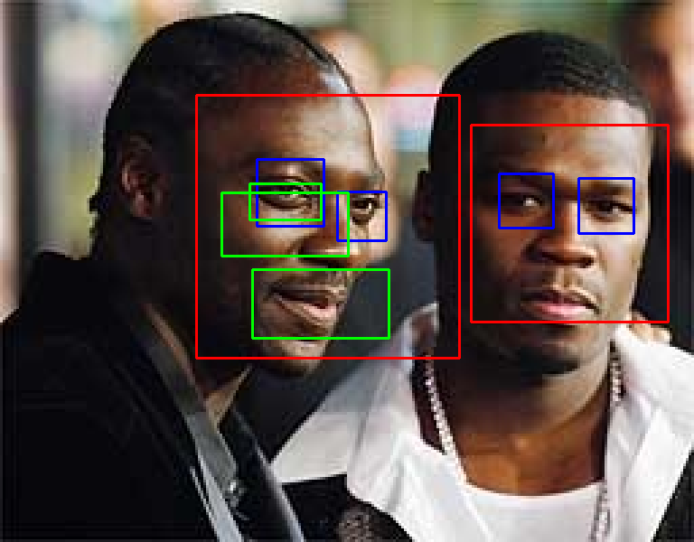


Face: scaleFactor=1.2, minNeighbors=5

Slide 12
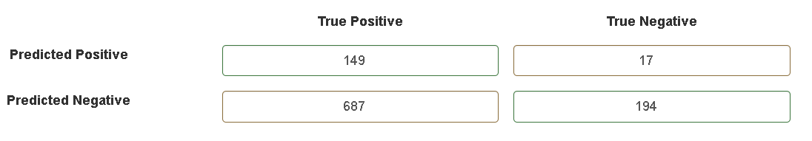
Confusion Matrix Eyes
Specificity = Negatives that are actually predicted as negative: 91.94%
Precision = Positive predictions that are actually positive: 89.76%
Accuracy = Correctly predicted part of all predictions: 32.76%

Slide 13
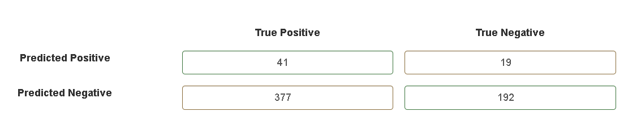
Confusion Matrix Smiles
Specificity = Negatives that are actually predicted as negative : 91%
Precision = Positive predictions that are actually positive: 68.33%
Accuracy = Correctly predicted part of all predictions: 37.04%

Slide 14
Thank you for your attention!

